Slide 1

Android Security
A Hacker Perspective
Reversing.ID
Revealing the Truth through Breaking Things

Slide 2




Hi!
I am Satria Ady Pradana
Cyber Security Consultant
@
Mitra Integrasi Informatika
xathrya
@xathrya
Reversing.ID
Revealing the Truth through Breaking Things

Slide 3
1.
Define Security!

Slide 4
Security is a process, not a product.

Slide 5

Growth of Technology
The Past and Present

Slide 6
Back then, only few people or organizations can afford it. Now everyone can.
Everything has their electronic or digital equivalent.
Used by companies, government, military, or individuals to replace the manual works.
Nearly every aspect of our life has been affected by technology.
Things getting smarter.
Reduces in size.
More connected than before.

Slide 7

Cyberspace Around You
It’s hard to not depend on IT technology.

Slide 8






Your Dependency to Digital Technology
Communication.
Entertainment.
Finansial.
Education.
News.
Etc.. Etc..

Slide 9
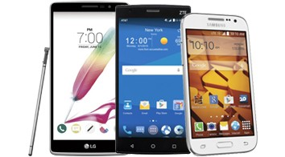
The Role of Mobile Devices
Key Component for Digital Society in Consumers End.
Notes:
Termasuk mobile phone.
Mobile phone dan gadget adalah perangkat penting yang mendukung ekosistem cyber.
- kecil, ringan, terhubung dengan internet, customizable.

Slide 10
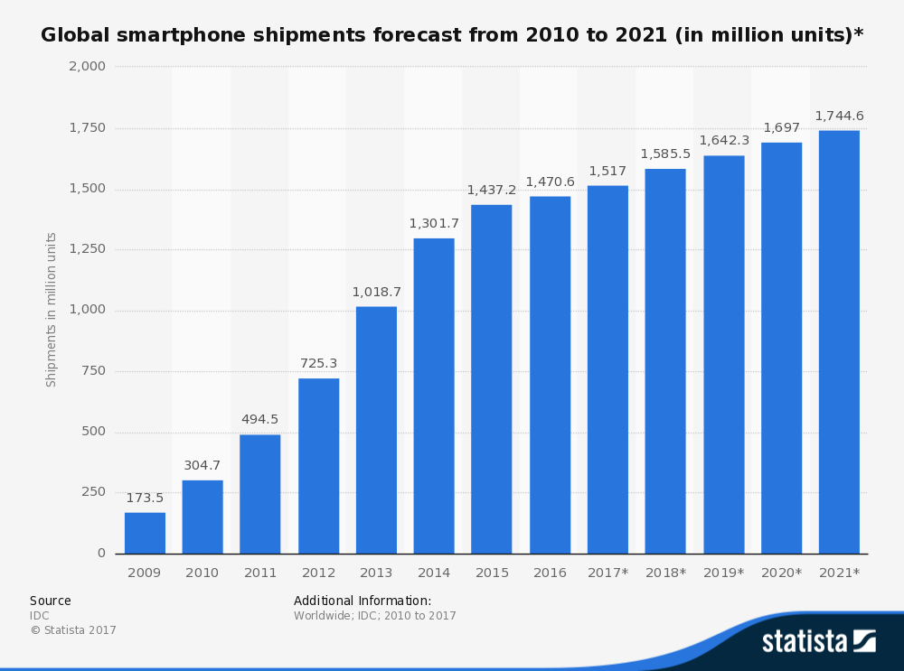
https://www.statista.com/statistics/263441/global-smartphone-shipments-forecast/

Slide 11
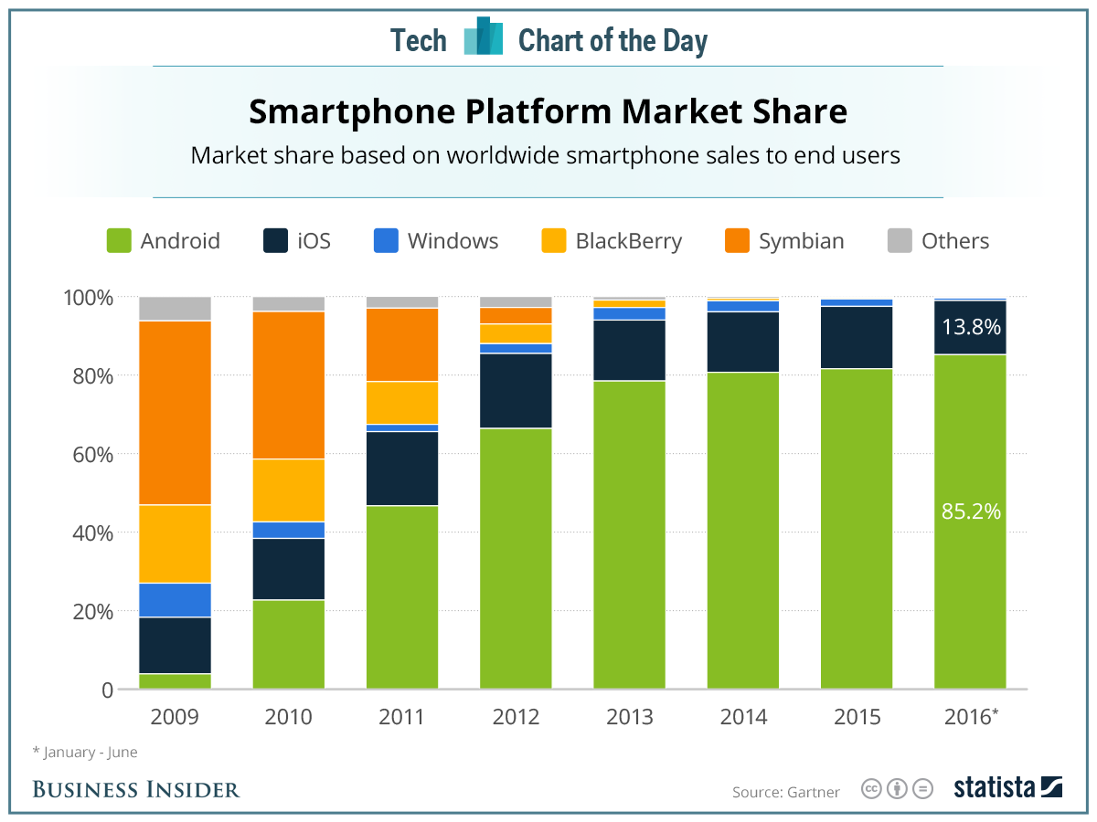
http://www.businessinsider.sg/smartphone-market-share-android-ios-windows-blackberry-2016-8

Slide 12
Android Getting More Dominant

Slide 13
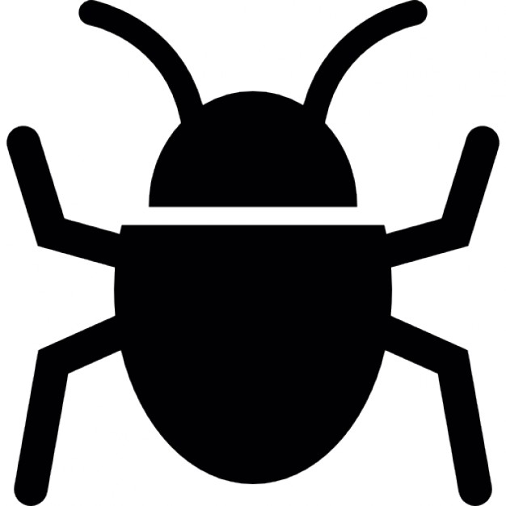
The Threats
Notes:
Begitu maraknya pemakaian teknologi menciptakan ancaman.
Kenapa?
Apa saja ancamannya?

Slide 14
With Great Userbase Comes Great Threats

Slide 15
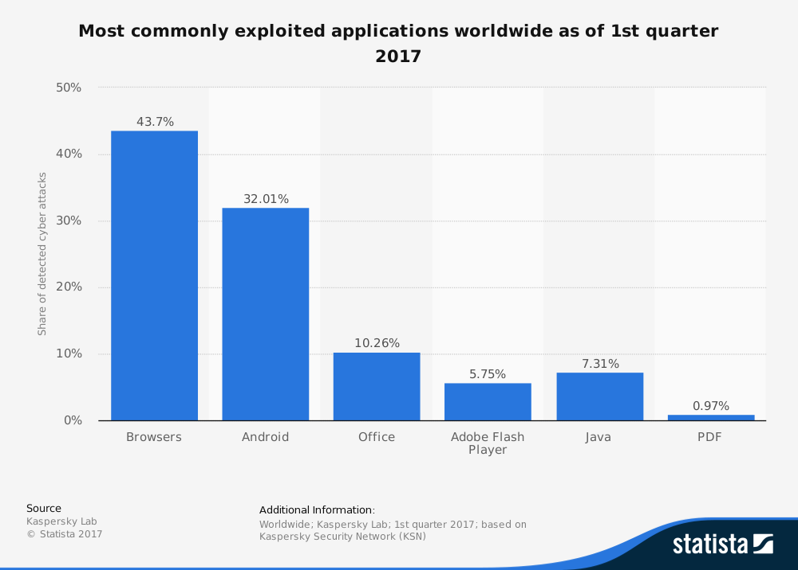
https://www.statista.com/statistics/434880/cyber-crime-exploits/

Slide 16
Incidents Drived by Motives
Financials Gain
Political Gain
Revenge and Defamation
Thrill and Entertainment

Slide 17
Security is not a product. To deal with a threat, you need to know the correct process to countermeasure.

Slide 18
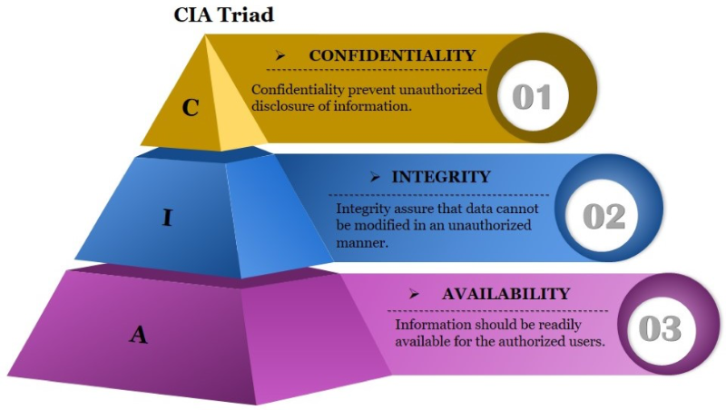

Slide 19
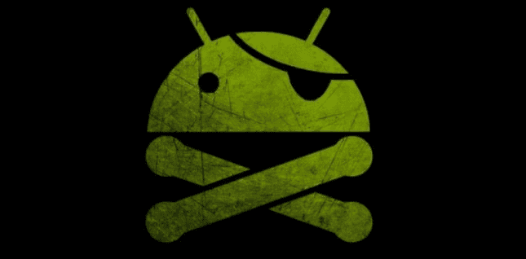
2.
Android Hacking
means....

Slide 20
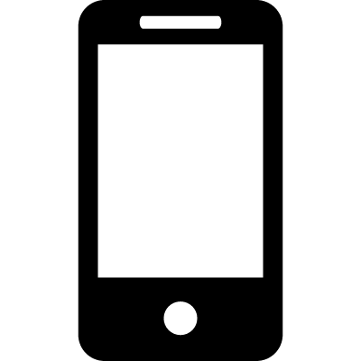
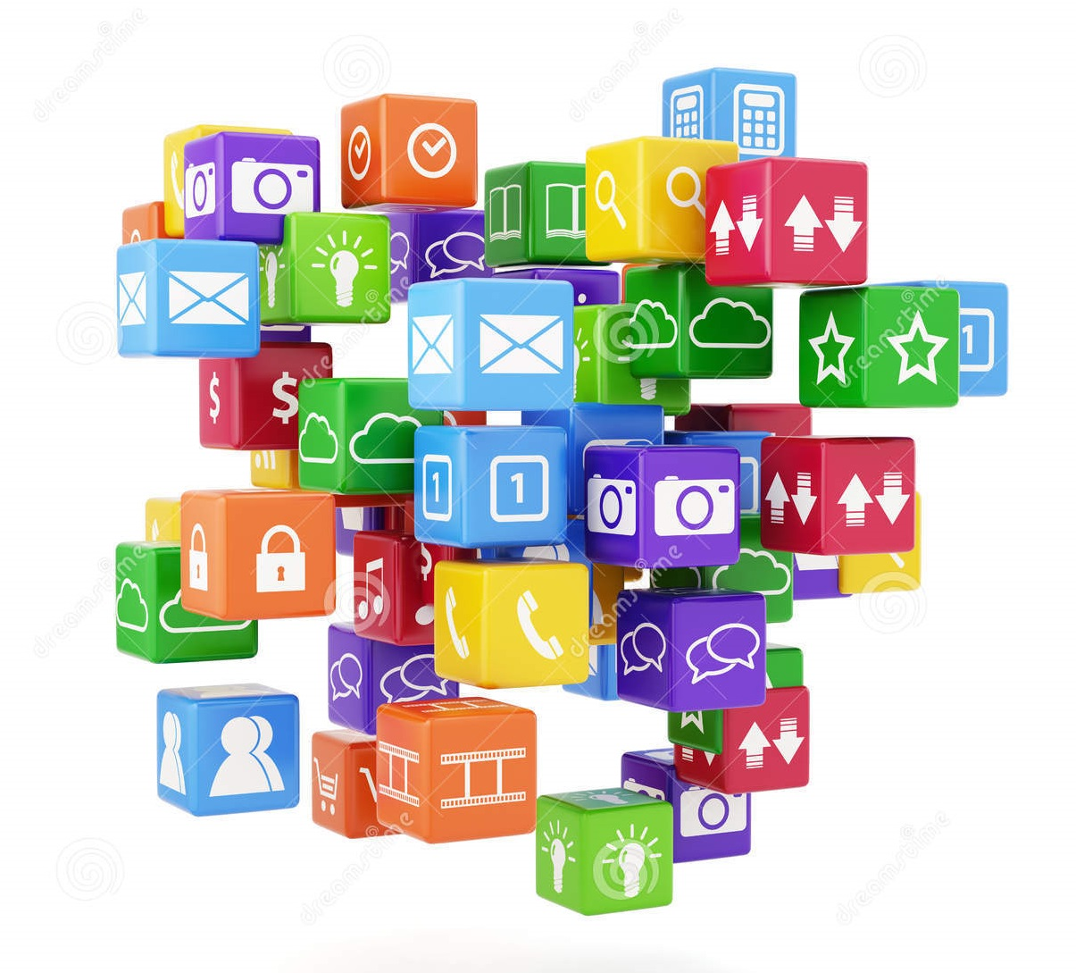
Devices &
Operating System
Applications
(Software)

Slide 21
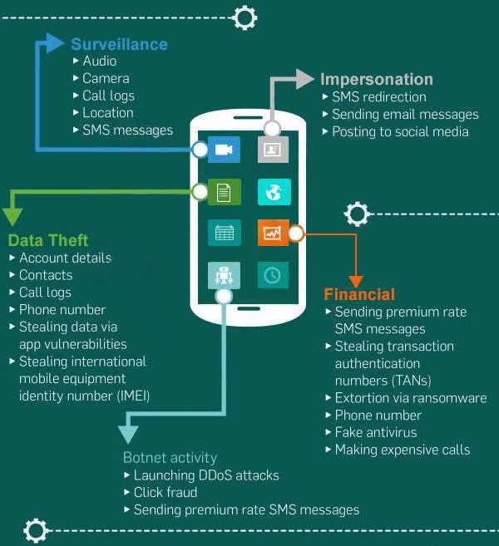

Slide 22
Demo 1: Android RAT
Remote Access Tool

Slide 23

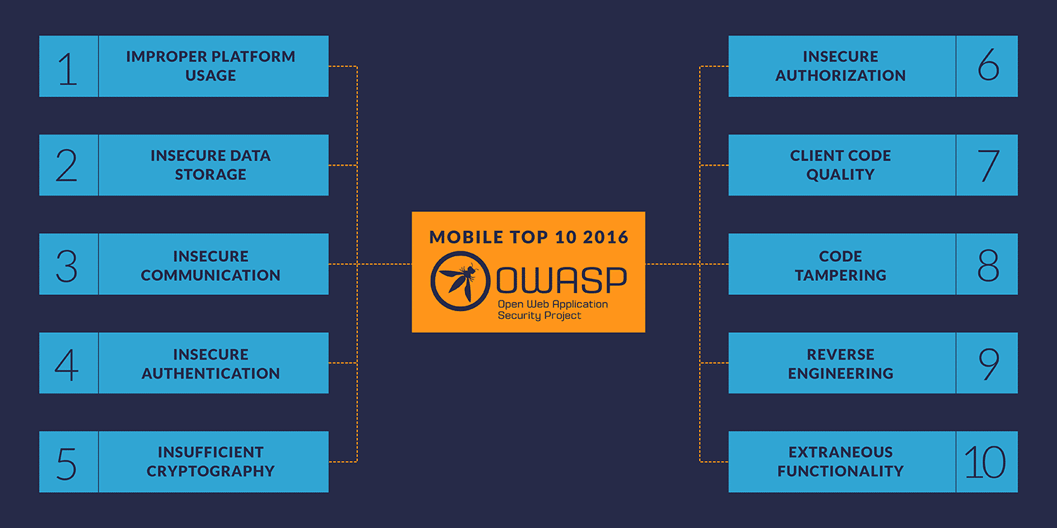

Slide 24
3.
Exploiting Android Application

Slide 25
The Joy of Android Apps Exploitation
The application is in your possession.
Basically it tell us to do anything.
Your Code is Mine

Slide 26
Our Goal (Mostly)
Obtain the Sensitive Data
Get the Algorithm
Take over
Manipulate

Slide 27
Exploitation is not always about taking over mobile devices!
It is about taking advantage of vulnerability

Slide 28
Analysis Lab
Anything you need to prepare

Slide 29
Set Up Tools and Environment
Android Device / Emulator
Disassembler
Decompiler
HTTP / TCP Proxy for MITM
Packet Sniffer
Dynamic Binary Instrumentation

Slide 30
Analysis Technique
Anything you need to know

Slide 31


C O D E
D A T A
Static Analysis
Dynamic Analysis
Dynamic Binary Instrumentation
Traffic Analysis
Taint Analysis
Notes:
Static
Dynamic

Slide 32
Vulnerable Point
Where should I look?

Slide 33
Demo 2: Exploiting Vulnerable Apps

Slide 34
4.
Real Life Cyber Security Activity

Slide 35
Android Application is not Stand Alone!

Slide 36
Thanks!
Any questions?

